Slide 1


GPU-accelerated
Cardiac Electrophysiological Simulation
Milestone 1I
Zirui Zang (zzang@seas.upenn.edu) 20211117

Slide 2
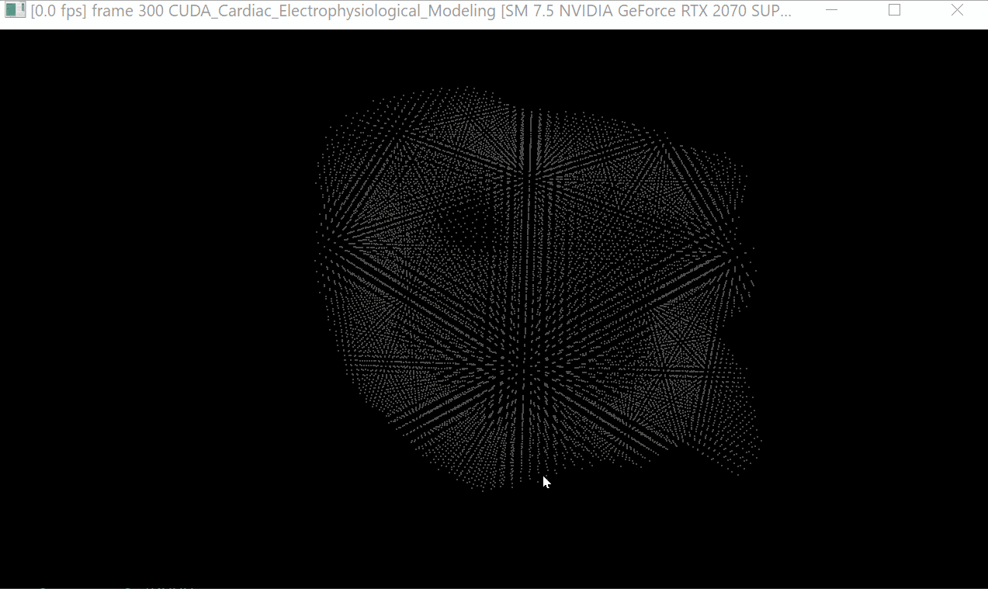
Simulation Demo

Slide 3
Project Progress
Preprocessed Data
Data Handler
Compute Kernels
Visualizer
Deployment & Testing
Finished:
Adopting the HW1 visualizer to plot the model geometry and output result. (One problem remain)
Programing different implementations.
On-going:
Deployment and tests on different platforms.

Slide 4
Speed Comparison
 | Matlab | C++ Eigen | GPU naive | GPU optimized | GPU float
time(s) | 140 | 37 | 2.2 | 2.0 | 1.8
speed vs. | 1x | 3.8x (1x) | 63x | 70x (18.5x) | 78x
Above table shows the simulation time comparison. Between GPU and CPU computing, there is a 18.5x speed increase. The example simulation has approx. 13000 voxels. If the model is more complex, there will be more speed difference.
There is a 10% increase between memory optimized version and naive version and another 10% increase if float is used in computation.
CPU: Ryzen 3700x, GPU: RTX2070s

Slide 5
Details on Memory Optimization
Each voxel requires 18 neighborhood indices and 20 coefficients. All of these are fixed throughout the simulation. The neighborhood indices are pre-calculated and are used to access the previous simulation results in the global memory.
Currently memory coalescing is used to optimize the performance. Because all voxels don’t share any information. So far no shared memory is used in optimization.
Even if the kernel function is empty, it takes ~1700ms to launch the kernel for each simulation step (currently 40000 times). Is there a way to improve the performance?

Slide 6
Current memory coalescing
Naive:
Optimized:
...
...
...
...
Coeffi 1 for each voxel
Coeffi 2 for each voxel
Coeffi 3 for each voxel
...
32 Coeffi 1
32 Coeffi 2
32 Coeffi 2
The above method gave the 10% improvement Block size is set to be 32. Reason on next page.

Slide 7
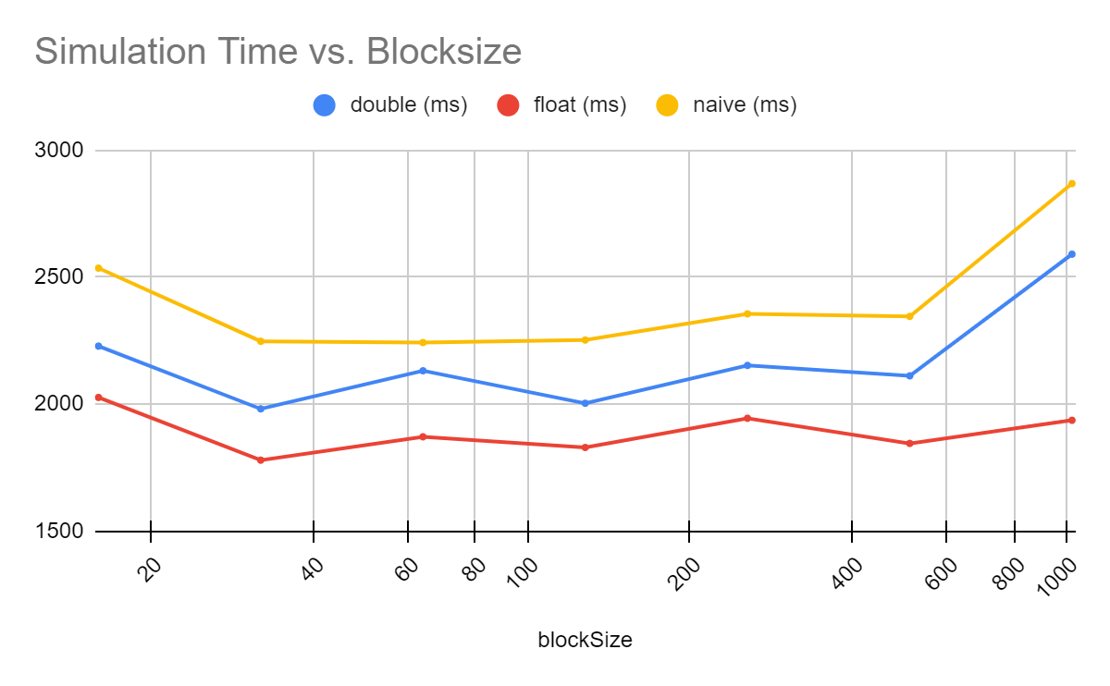
Time vs. Blocksize

Slide 8
Planned Performance Analysis & Deployments
We will analyze three different versions of compute kernels and compare with the reference Matlab version:
CPU version, based on C++ Eigen library (done)
GPU naive version (done)
GPU optimized version, with expected memory and other optimizations. (looking for further optimization)
We will deploy the simulator in three different platforms:
Server platform w/ RTX A6000 GPU (x64 Linux compile)
Workstation platform w/ RTX 2070s GPU (x64 Windows compile)
Embedded platform w/ Nvidia Jetson Xavier NX (Arm Linux compile)

Slide 9
Discussion
With the A6000, we may be able to fit in all voxel in one kernel call, so is it possible to get device-wise sync. If possible, it will save a lot of kernel call and coefficient memory fetching time.
How to compile for other GPUs? Is there some resources on that.

